Slide 1
Knowledge Distillation
2021.03.25
심아름

Slide 2
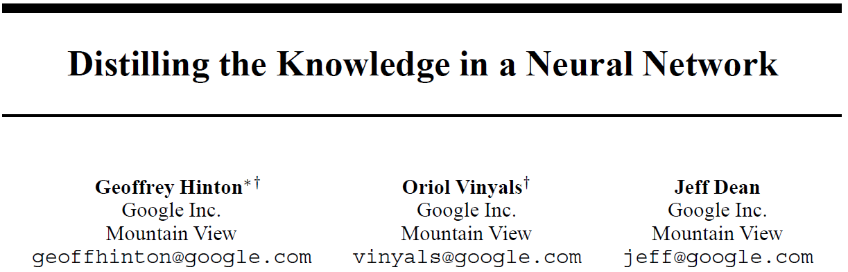
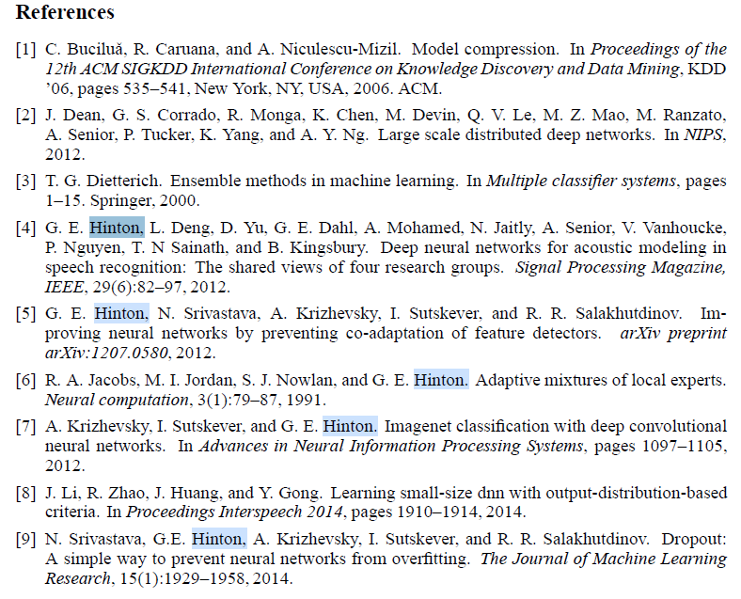
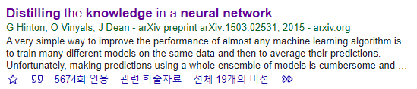

Slide 3

Distilling the knowledge in a neural network
Model T
Domain A
train
Model T
Ouput
Model T
Model T
Ensemble
Distillation
Model S

Slide 4
Knowledge Transfer
Transfer Learning
Knowledge Distillation
Domain A
Model T
train
Model A
Domain A
train
transfer
transfer
Domain B
train
Model B
train
Model S
서로 다른 도메인
타겟 도메인의 데이터가 부족하거나, label이 없을 때
동일한 도메인
미리 잘 학습된 큰 모델을 이용하여 실제로 사용하는 작은 모델의 성능을 향상
( model compression )

Slide 5
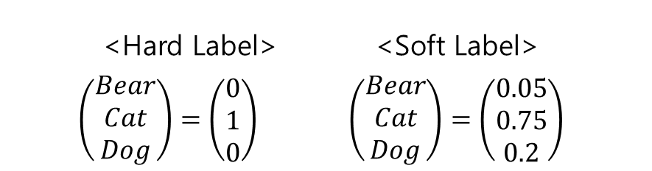
Knowledge Distillation
Model T
Model T
Model T
train
Knowledge from pre-trained Teacher Network Model T
= Softmax Output of T
= Soft Label of T
= Dark Knowledge of T
Model T
Domain A
Knowledge
<Hard Label> <Soft Label>
$$\left(\begin{aligned}Bear \\ Cat \\ Dog\end{aligned}\right)=\left(\begin{aligned}0 \\ 1 \\ 0\end{aligned}\right) \left(\begin{aligned}Bear \\ Cat \\ Dog\end{aligned}\right)=\left(\begin{aligned}0.05 \\ 0.75 \\ 0.2\end{aligned}\right)$$
train
Model S

Slide 6
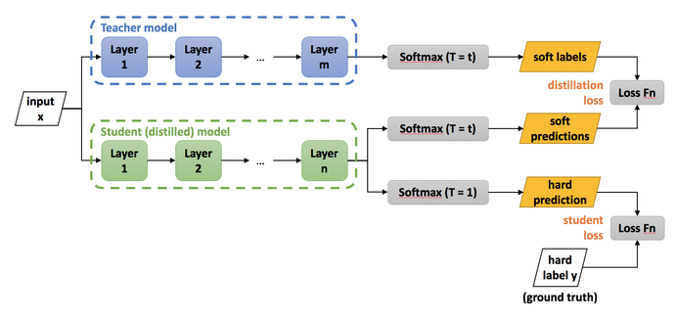

Knowledge Distillation
$$Total Loss : \left(1−α\right)L_{CE}\left( σ\left(Z_{s}\right), y\right) + αL_{CE}\left( σ\left(\frac{Z_{s}}{T}\right),σ(\frac{Z_{t}}{T})\right)$$
$L_{CE}$ : Cross entropy loss
$σ$ : Softmax
$Z_{s}$ : Output logits of Student network
$Z_{t}$ : Output logits of Teacher network
y : Ground truth (one-hot)
$α$ : Balancing parameter
$T$ : Temperature hyperparameter
Notes:
We have found that using the original training set works well, especially if we add a small term to the objective function that encourages the small model to predict the true targets as well as matching the soft targets provided by the cumbersome model.

Slide 7
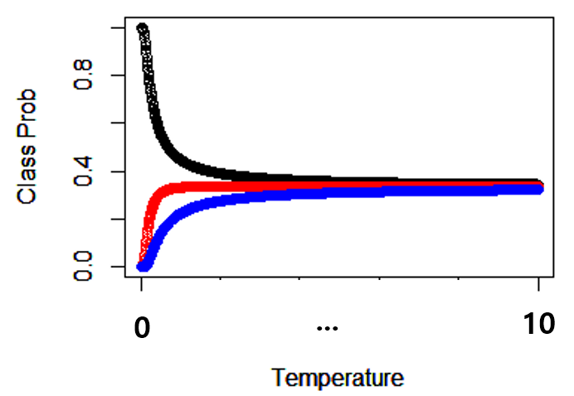
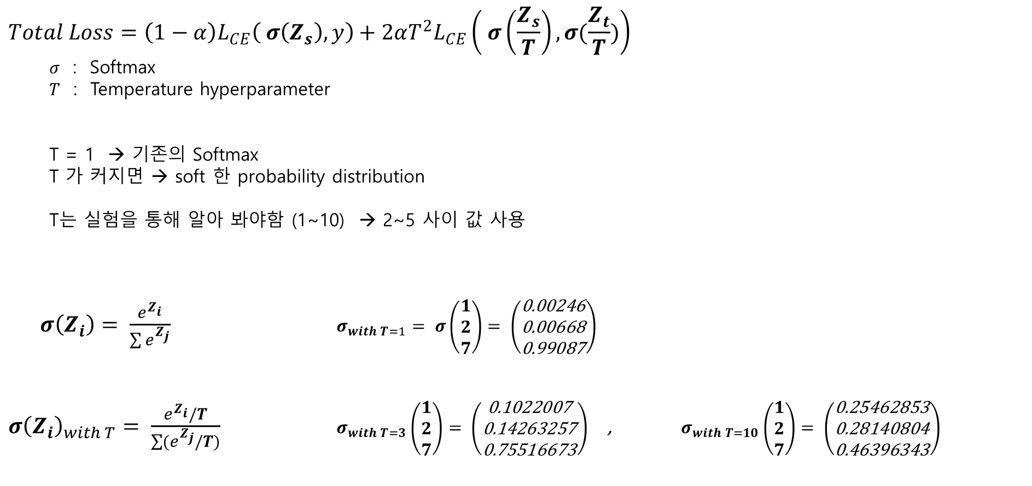
Temperature Scaling on Softmax
$$Total Loss=\left(1−α\right)L_{CE}\left( σ\left(Z_{s}\right), y\right)+2αT^{2}L_{CE}\left( σ\left(\frac{Z_{s}}{T}\right),σ(\frac{Z_{t}}{T})\right)$$
$σ$ : Softmax
$T$ : Temperature hyperparameter
T = 1 → 기존의 Softmax
T 가 커지면 → soft 한 probability distribution
T는 실험을 통해 알아 봐야함 (1~10) → 2~5 사이 값 사용
$σ\left(Z_{i}\right)= \frac{e^{Z_{i}}}{\sum{e^{Z_{j}}}}$ $σ_{with T=1}= σ\left(\begin{aligned}1 \\ 2 \\ 7\end{aligned}\right)= \left(\begin{aligned}\text{0.00246} \\ \text{0.00668} \\ \text{0.99087}\end{aligned}\right)$
${σ\left(Z_{i}\right)}_{with T}= \frac{e^{Z_{i}}/T}{\sum{(e^{Z_{j}}/T)}}$ $σ_{with T=3}\left(\begin{aligned}1 \\ 2 \\ 7\end{aligned}\right)= \left(\begin{aligned}\text{0.1022007} \\ \text{0.14263257} \\ \text{0.75516673}\end{aligned}\right)$ , $σ_{with T=10}\left(\begin{aligned}1 \\ 2 \\ 7\end{aligned}\right)= \left(\begin{aligned}\text{0.25462853} \\ \text{0.28140804} \\ \text{0.46396343}\end{aligned}\right)$

Slide 8
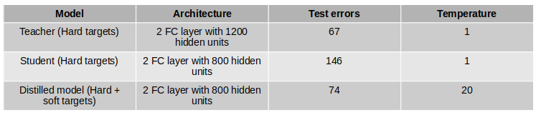
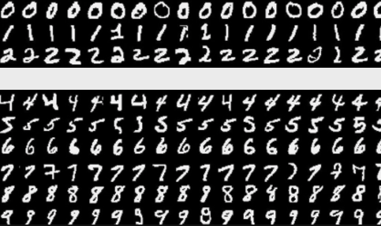
Experiments on MNIST
Result 1: MNIST image data
60,000 training cases, 10,000 test casesa
Result 2 : Student Model의 Training set에서 ‘3’ 제거
Teacher Model의 Softmax Ouput이 충분한 Knowledge 를 가지고 있다면,
학습되지 않은 label 예측이 가능
> test error = 109, test set의 ‘3’ 1010개 중 error : 14 (98.6% accuracy)

Slide 9
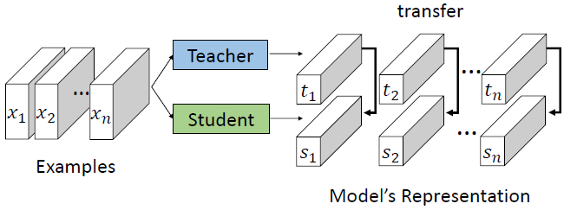
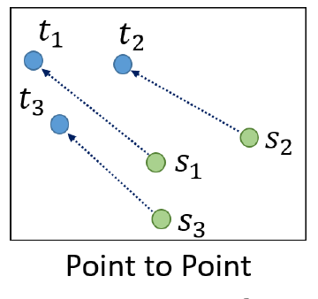
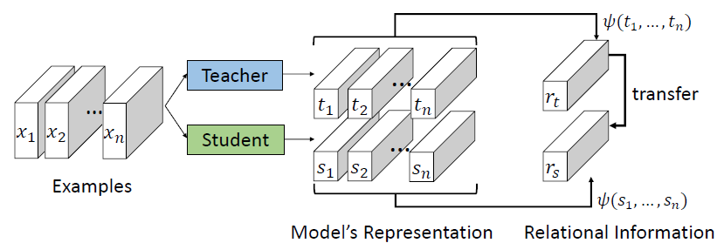
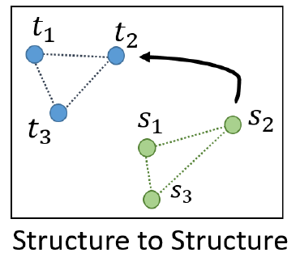
Relational Knowledge Distillation
Individual Knowledge Distillation
Relational Knowledge Distillation

Slide 10
Knowledge Distillation
Online Distillation : pre-train 된 Teacher Model
Offline Distillation : 멀티 GPU를 통하여 Teacher Model들과 Student Model을 병렬처리,
Teacher Model들의 평균을 이용
Self Distillation : Teacher 모델 학습 시 중간에 나오는 feature들의 앙상블 결과가 최종 예측과 동일하도록

Slide 12

Knowledge Distillation
$$Total Loss=\left(1−α\right)L_{CE}\left( σ\left(Z_{s}\right), y\right)+2αT^{2}L_{CE}\left( σ\left(\frac{Z_{s}}{T}\right),σ(\frac{Z_{t}}{T})\right)$$
$L_{CE}$ : Cross entropy loss
$σ$ : Softmax
$Z_{s}$ : Output logits of Student network
$Z_{t}$ : Output logits of Teacher network
y : Ground truth (one-hot)
$α$ : Balancing parameter
$T$ : Temperature hyperparameter
Notes:
We have found that using the original training set works well, especially if we add a small term to the objective function that encourages the small model to predict the true targets as well as matching the soft targets provided by the cumbersome model.

Slide 13




Cross-entropy Gradient
Student’s model
z : Output logits of Student network
q : Probability of Student network
Teacher’s model
v : Output logits of Teacher network
p : Probability of Teacher network
If T is high,
If logit have been zero-meaned,

